Slide 1
Lectures 13-16
CS436/536: Introduction to
Machine Learning
Zhaohan Xi
Binghamton University
^{zxi1@binghamton.edu}

Slide 2
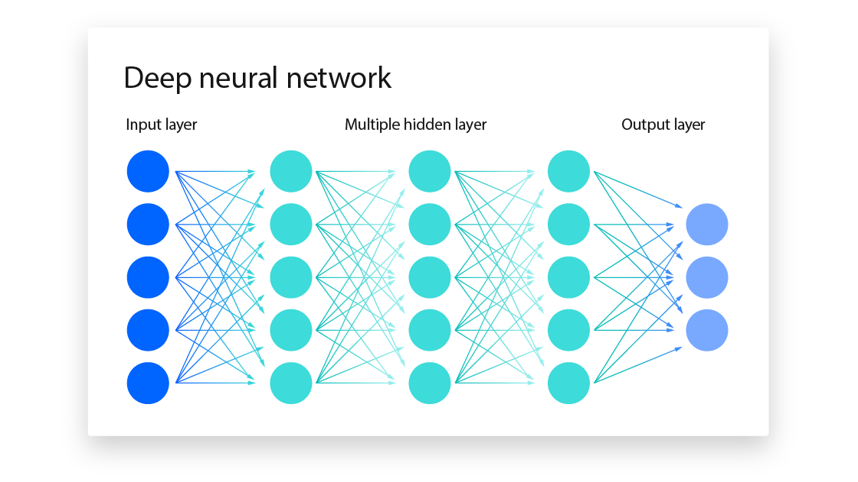

Slide 3

Convolutional Neural Network

Slide 4
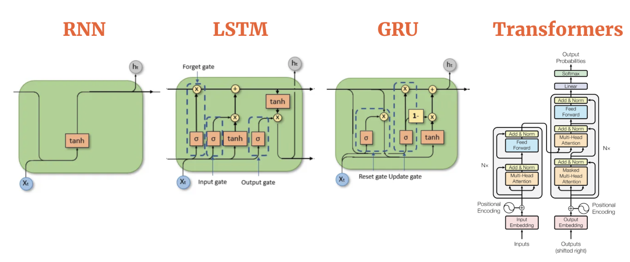

Slide 5
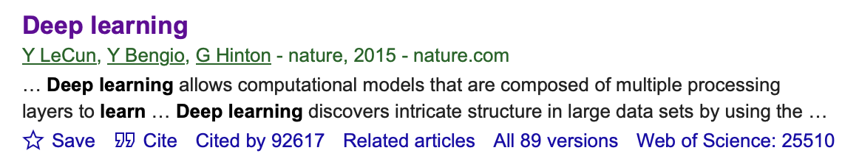

Slide 6
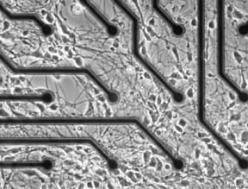
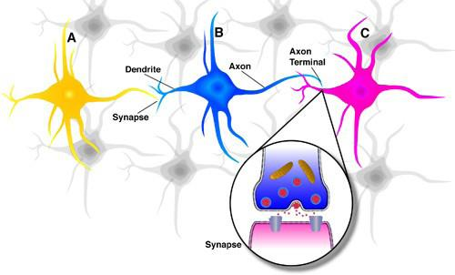
(Artificial) Neural Networks
Inspired by biological neural networks
interpreted by engineers
A generalization of the Perceptron Model
Using a feature transform learned from data

Slide 7
Reminder: The Perceptron Model
$$h=sign(w^{T}x)=sign\left(w_{0}+w_{1}x_{1}+w_{2}x_{2}\right)$$
$$1$$
$$w_{0}$$
$$w_{1}$$
$$x_{1}$$
$$sign\left(w^{T}x\right)$$
$$w_{2}$$
$$x_{2}$$

Slide 8
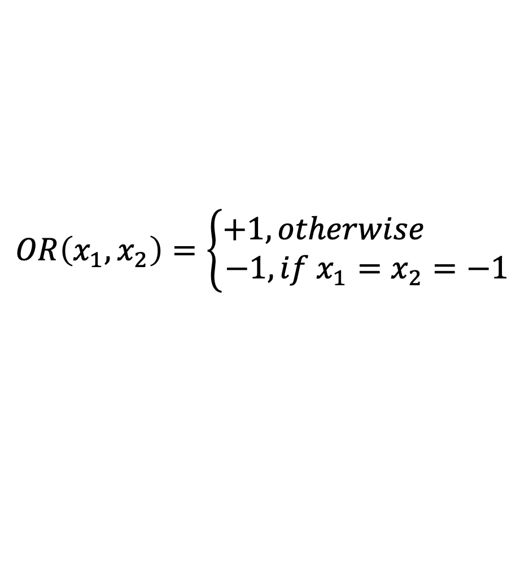
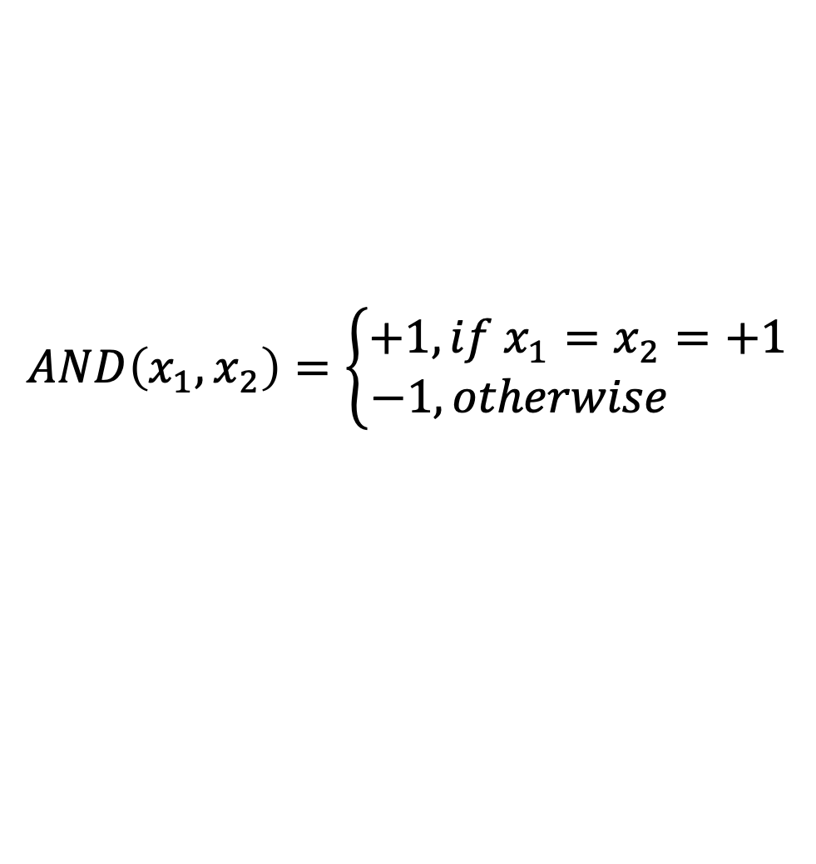
Perceptrons for OR and AND
OR($x_{1},x_{2}$)$=sign(x_{1}+x_{2}+1.5)$
AND($x_{1},x_{2}$)$=sign(x_{1}+x_{2}−1.5)$
$$1$$
1.5
$$1$$
-1.5
1
1
$$x_{1}$$
OR($x_{1},x_{2}$)
$$x_{1}$$
AND($x_{1},x_{2}$)
1
1
$$x_{2}$$
$$x_{2}$$
$$OR\left(x_{1},x_{2}\right)=\left\{\begin{aligned}+1, otherwise \\ −1,if x_{1}=x_{2}=−1\end{aligned}\right.$$
$$AND\left(x_{1},x_{2}\right)=\left\{\begin{aligned}+1, if x_{1}=x_{2}=+1 \\ −1, otherwise \end{aligned}\right.$$

Slide 9
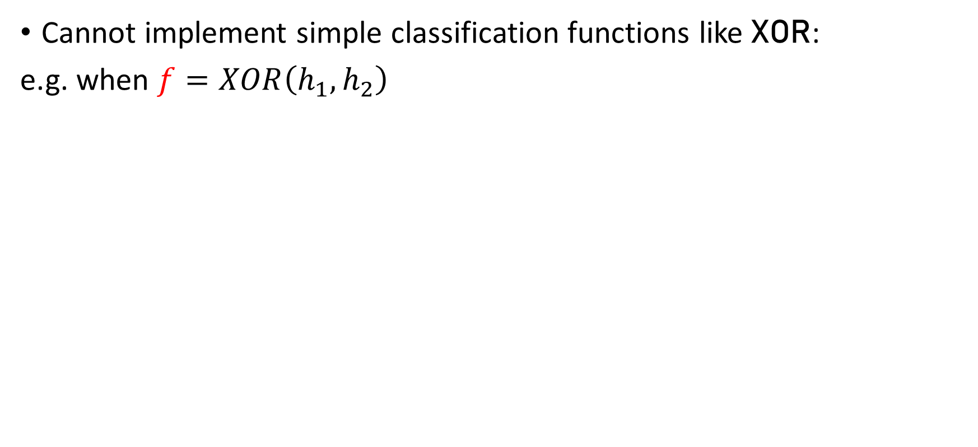

Limitations of the Perceptron Model
Cannot implement simple classification functions like XOR:
e.g. when $f=XOR\left(h_{1},h_{2}\right)$
A | B | XOR
-1 | -1 | -1
-1 | +1 | +1
+1 | -1 | +1
+1 | +1 | -1
$$f:$$

Slide 10
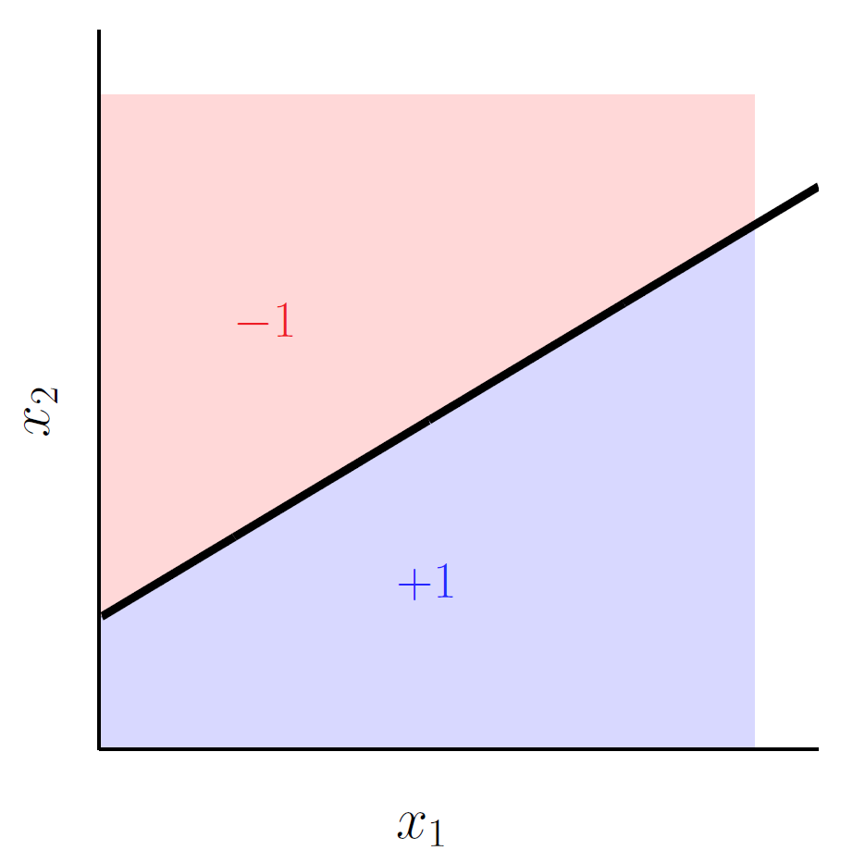
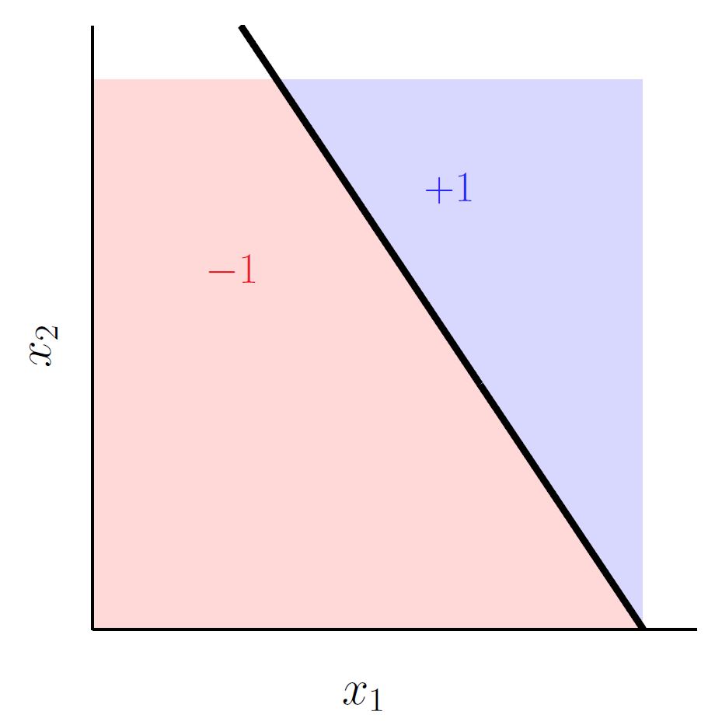
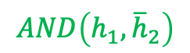
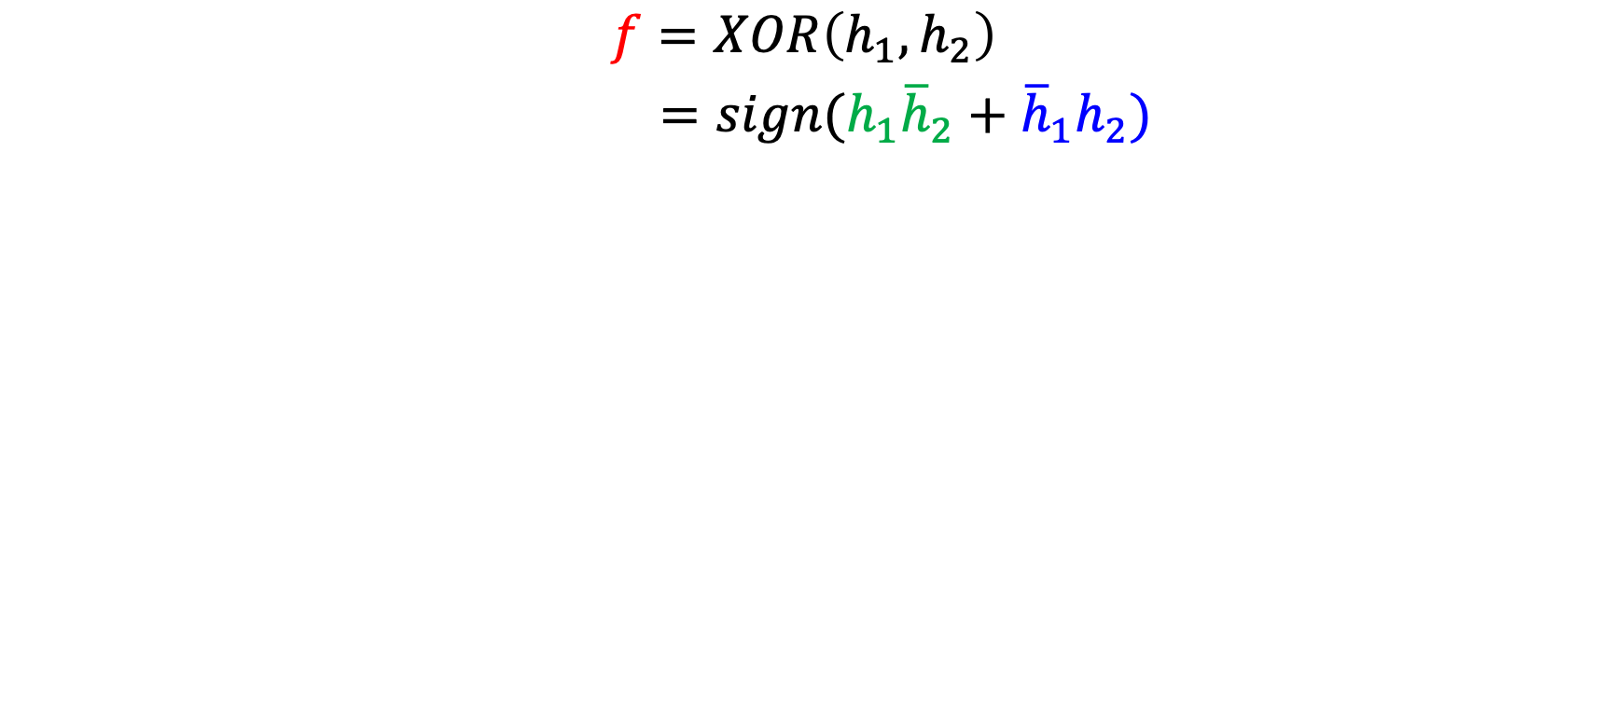
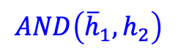
Decomposing XOR
$$f=XOR\left(h_{1},h_{2}\right)$$
$=sign(h_{1}{\overline{h}}_{2}+{\overline{h}}_{1}h_{2})$
$$AND\left(h_{1},{\overline{h}}_{2}\right)$$
OR
$$AND\left({\overline{h}}_{1},h_{2}\right)$$
$$h_{1}\left(x\right)=sign(w_{1}^{T}x)$$
$$h_{2}\left(x\right)=sign(w_{2}^{T}x)$$

Slide 11
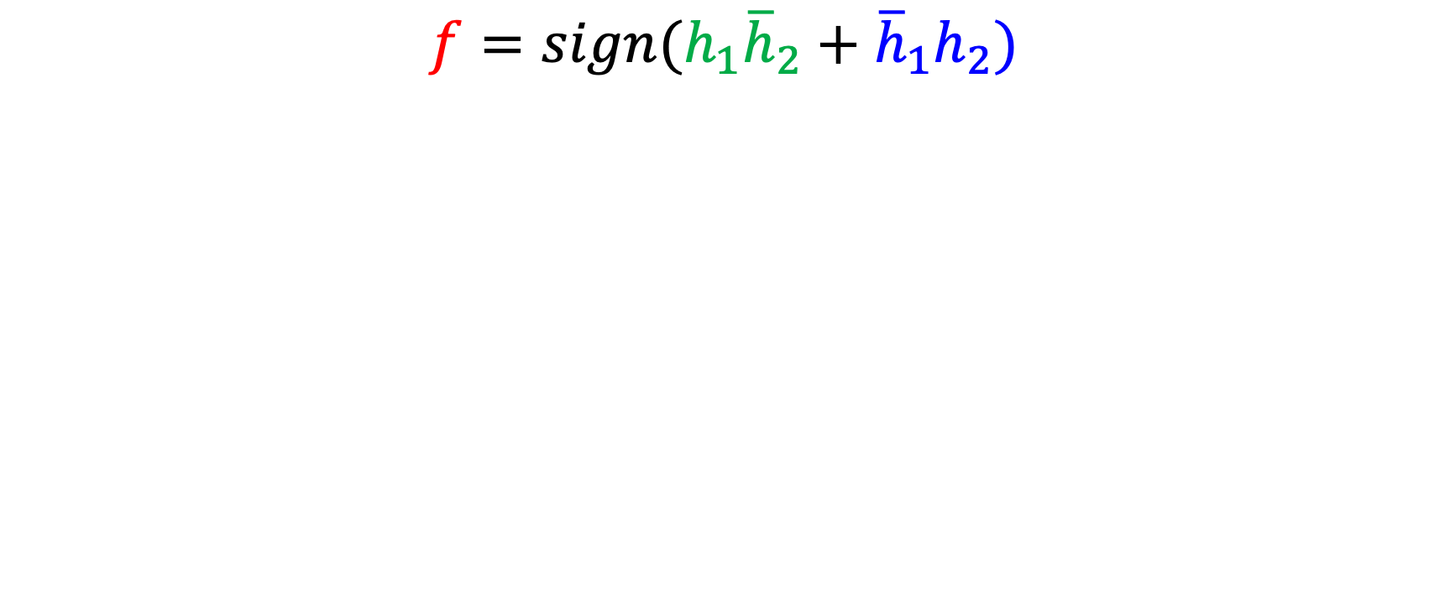
Representing $f$ XOR using OR and AND
$$f=sign(h_{1}{\overline{h}}_{2}+{\overline{h}}_{1}h_{2})$$
$$1$$
1.5
1
$$h_{1}{\overline{h}}_{2}$$
$$f$$
1
$${\overline{h}}_{1}h_{2}$$

Slide 12
Representing $f$ XOR using OR and AND
$$f=sign(h_{1}{\overline{h}}_{2}+{\overline{h}}_{1}h_{2})$$
$$1$$
-1.5
$$1$$
1.5
$$h_{1}{\overline{h}}_{2}$$
1
-1.5
1
$$h_{1}$$
$$f$$
1
$${\overline{h}}_{1}h_{2}$$
-1
-1
$$h_{2}$$
1

Slide 13
Representing $f$ XOR using OR and AND
$$f=h_{1}{\overline{h}}_{2}+{\overline{h}}_{1}h_{2}$$
$$h_{1}=w_{1}^{T}x$$
$$h_{2}=w_{2}^{T}x$$
$$1$$
$$1$$
-1.5
$$1$$
1.5
$$w_{1}^{T}x$$
1
-1.5
1
$$x_{1}$$
$$f$$
1
-1
-1
$$x_{2}$$
$$w_{2}^{T}x$$
1

Slide 14
The Multi-Layer Perceptron (MLP)
Multiple layers of perceptrons
that are used
in a cascading manner
Modify the weights on perceptrons to implement different functions
$$1$$
$$1$$
-1.5
$$1$$
1.5
$$w_{1}^{T}x$$
1
-1.5
1
$$x_{1}$$
$$f$$
1
-1
-1
$$x_{2}$$
$$w_{2}^{T}x$$
1
Inputs
Hidden Layers
(3) Layers
More layers between the input and output
Helps implement $f$

Slide 15
The Multi-Layer Perceptron (MLP)
$$1$$
$$1$$
-1.5
$$1$$
1.5
$$w_{1}^{T}x$$
1
-1.5
1
$$x_{1}$$
$$f$$
1
-1
-1
$$x_{2}$$
$$w_{2}^{T}x$$
1
Inputs
# units
=
# linear separators used to decompose $f$
$AND$functions
one for each positive region
$OR$ function
More layers between the input and output
Helps implement $f$

Slide 16
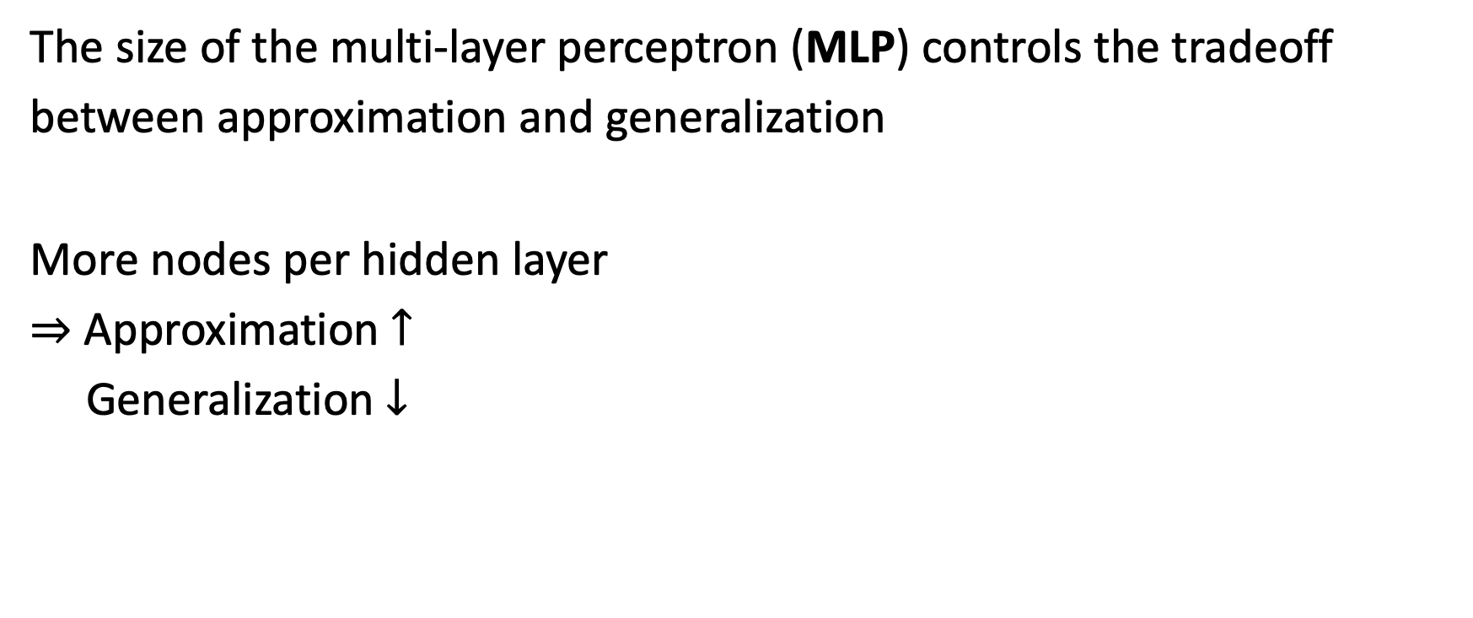
Approximation vs. Generalization
The size of the multi-layer perceptron (MLP) controls the tradeoff
between approximation and generalization
More nodes per hidden layer
$⇒$ Approximation $↑$
Generalization $↓$

Slide 17
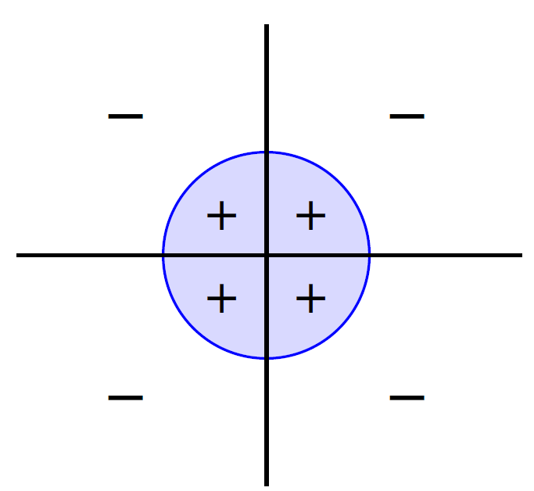
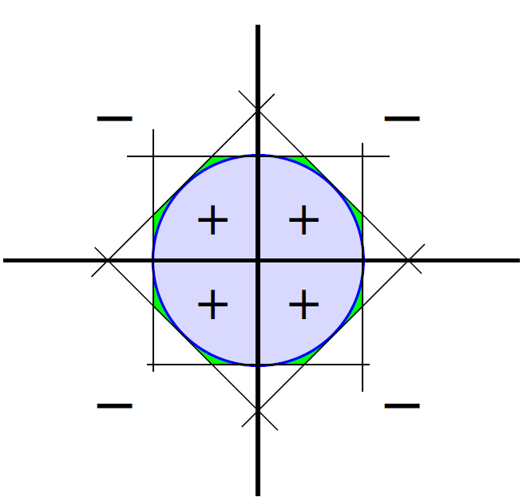
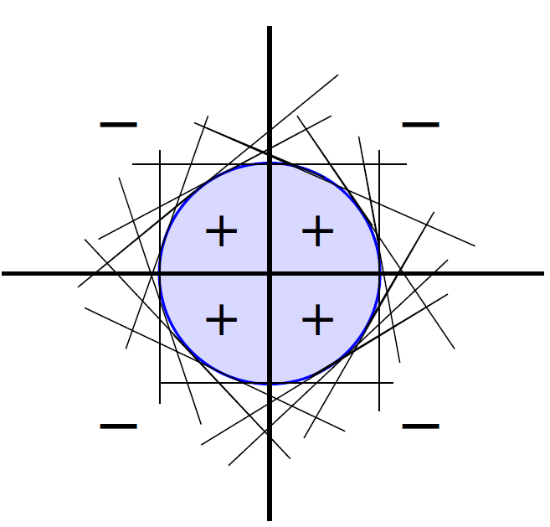
Universal Approximation
If $f$ is sufficiently smooth
and continuous
If $f$ can be decomposed into linear separators
Then, it can be implemented using a 3-layer perceptron

Slide 18
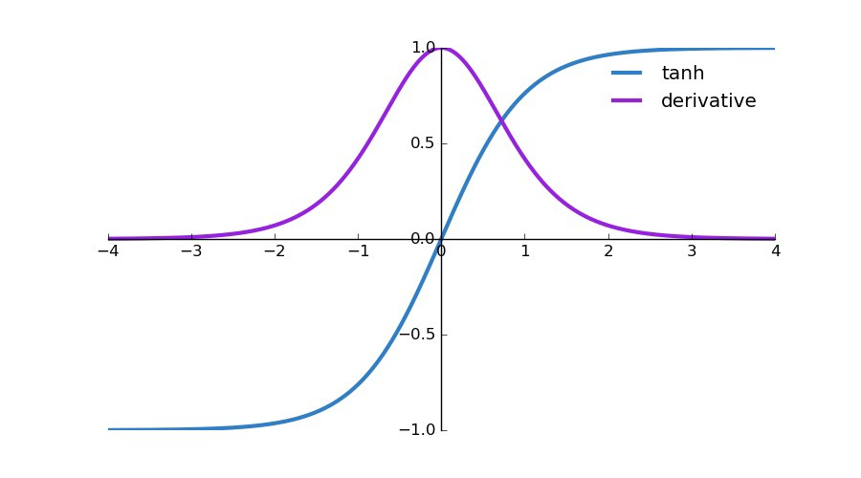
Fitting the Data / Minimizing $E_{in}$
An even harder combinatorial optimization problem with MLP
than with the simple Perceptron
$E_{in}$ is not smooth due to use of $sign\left(⋅\right)$ function
$⇒$ Cannot use gradient descent
Replace $sign(s)$ with $tanh⁡(s)$
$sign(s)≈tanh⁡(s)$ - a sigmoid function
Allows use of gradient descent

Slide 19
The Neural Network
$$1$$
$$1$$
$$1$$
$$x_{1}$$
$$θ$$
$$θ$$
$$θ$$
$$h(x)$$
$$x_{2}$$
$$θ$$
$$θ$$
$i$-th node
$$⋮$$
$$θ$$
$$d^{(l)}$$
dimension of layer $l$
$$x_{d}$$
Input layer
$$l=0$$
Hidden layers
$$0<l<L$$
Output layer
$$l=L$$

Slide 20

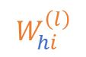
Anatomy and Physiology of a Hidden Node
$$W^{(l)}$$
$$W^{(l+1)}$$
$$θ$$
$$s_{i}^{(l)}$$
$$x_{i}^{(l)}$$
+
$$θ$$
$$W_{hi}^{\left(l\right)}$$
$h$-th node
$i$-th node
layer
$$l−1$$
layer
$$l$$
layer
$$l+1$$
1
$x^{(l)}$ | $d^{(l)}+1$ dimensional output vector

Slide 21
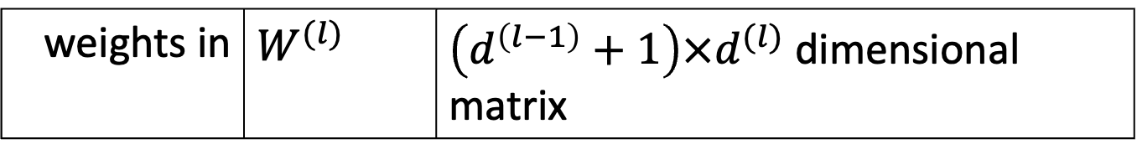
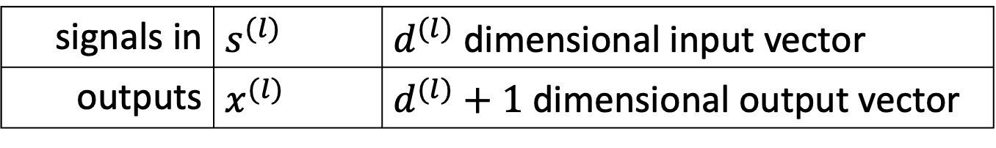
Anatomy and Physiology of a Hidden Node
$$W^{(l)}$$
$$W^{(l+1)}$$
$$θ$$
$$s_{i}^{(l)}$$
$$x_{i}^{(l)}$$
+
$$θ$$
$$W_{hi}^{\left(l\right)}$$
$h$-th node
$i$-th node
layer
$$l−1$$
layer
$$l$$
layer
$$l+1$$
signals in | $s^{(l)}$ | $d^{(l)}$ dimensional input vector
outputs | $x^{(l)}$ | $d^{(l)}+1$ dimensional output vector
1
weights in | $W^{(l)}$ | $\left(d^{\left(l−1\right)}+1\right)×d^{(l)}$ dimensional matrix

Slide 22
Anatomy and Physiology of a Hidden Node
$$W^{(l)}$$
$$W^{(l+1)}$$
layer $l$
has “dimension” $d^{(l)}$
i.e. $d^{(l)}+1$ nodes
$$W^{(l)}=\left[\begin{aligned}w_{1}^{(l)}w_{2}^{(l)}…w_{d^{(l)}}^{(l)} \\ \\ \end{aligned}\right]$$
$$θ$$
$$s_{i}^{(l)}$$
$$x_{i}^{(l)}$$
+
$$θ$$
$$W_{hi}^{\left(l\right)}$$
$h$-th node
$i$-th node
layer
$$l−1$$
layer
$$l$$
layer
$$l+1$$
signals in | $s^{(l)}$ | $d^{(l)}$ dimensional input vector
outputs | $x^{(l)}$ | $d^{(l)}+1$ dimensional output vector
weights in | $W^{(l)}$ | $\left(d^{\left(l−1\right)}+1\right)×d^{(l)}$ dimensional matrix
weights out | $W^{(l+1)}$ | $\left(d^{\left(l\right)}+1\right)×d^{(l+1)}$ dimensional matrix

Slide 23

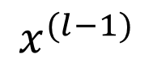
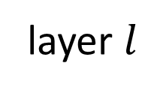
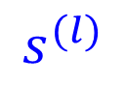
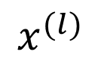


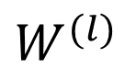
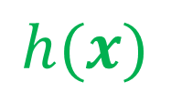
Anatomy and Physiology of a Layer
Input
Signal
+
node $i$
$$x^{(l−1)}$$
$$W^{(l)}$$
$$s^{(l)}$$
$$θ$$
$$x^{(l)}$$
$$⋯$$
$$h(x)$$
layer $l$

Slide 24
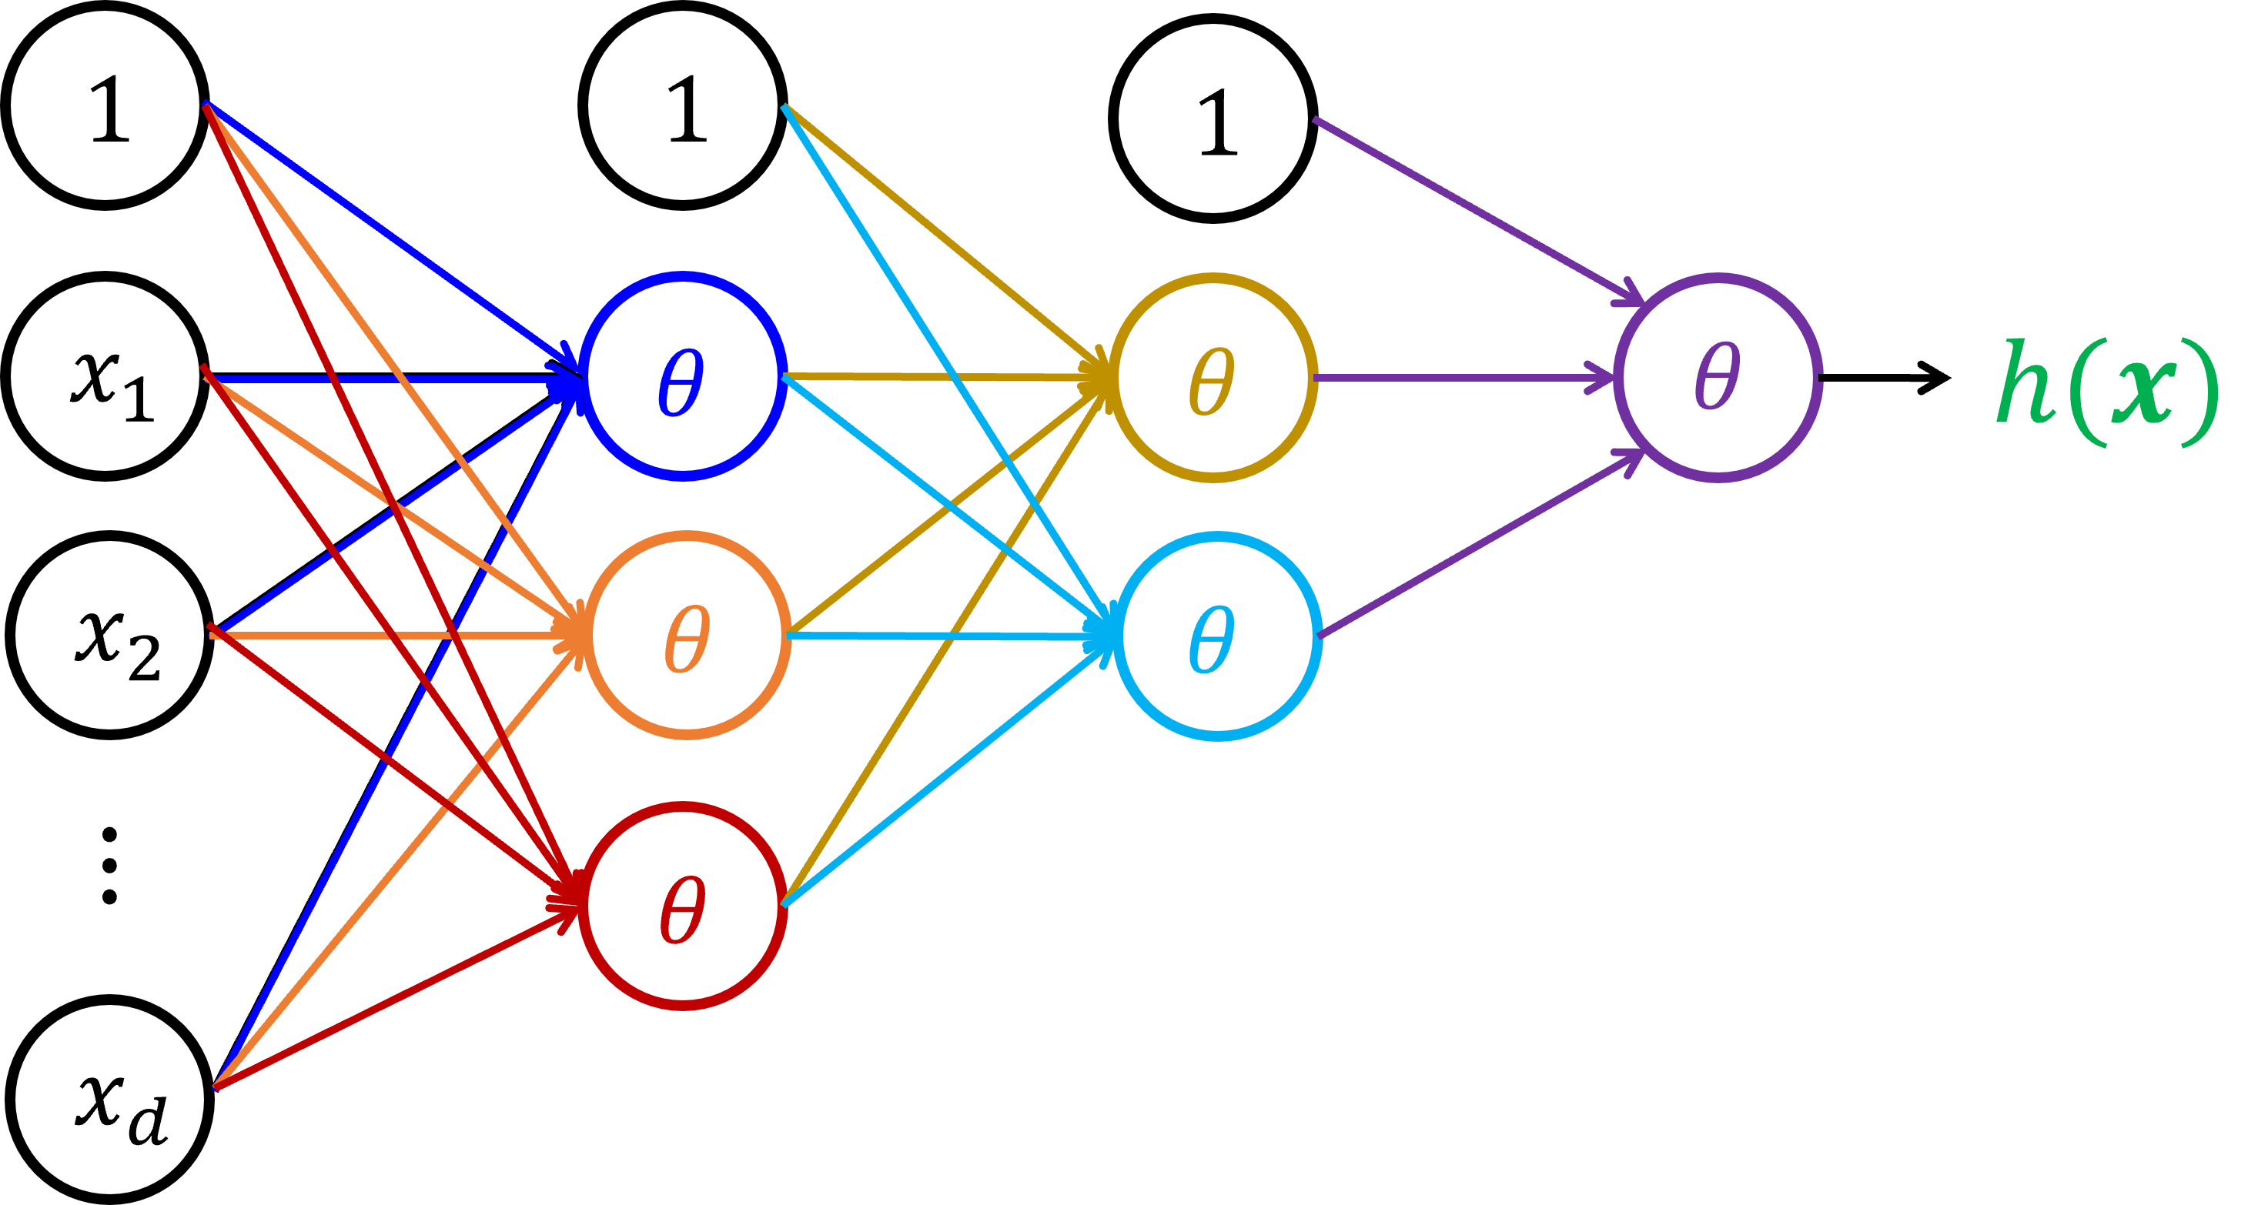
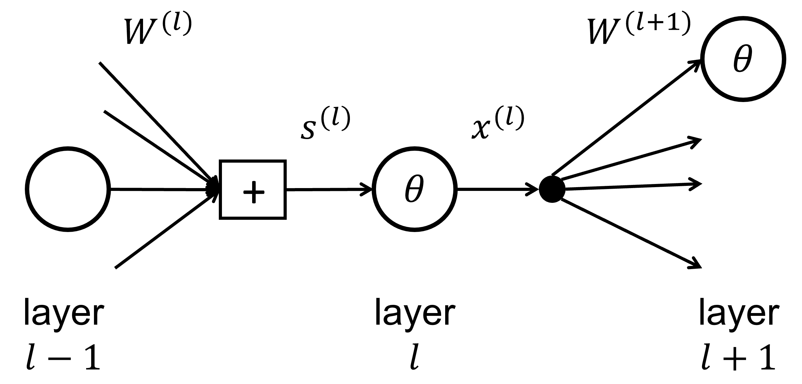

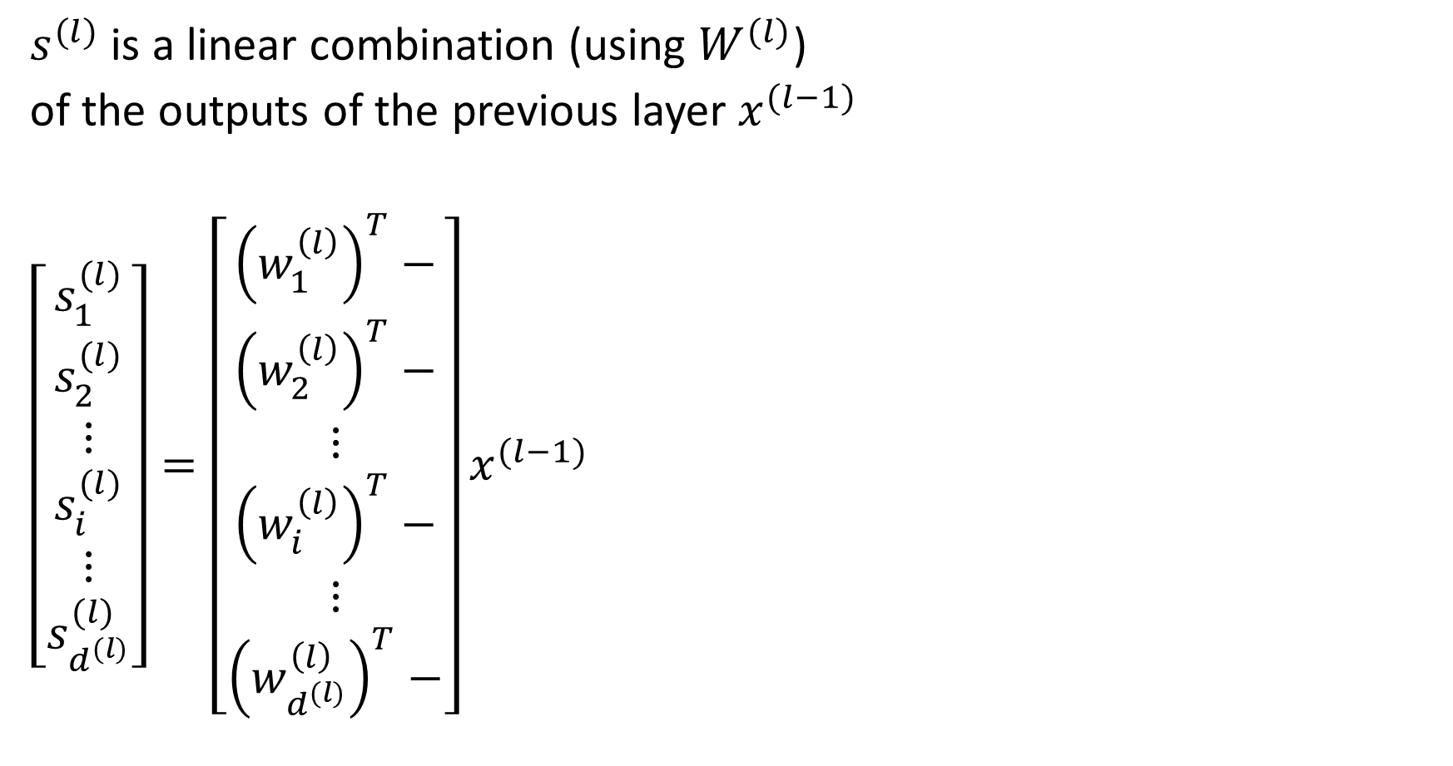
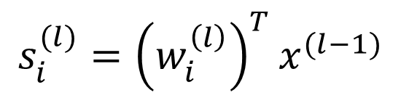

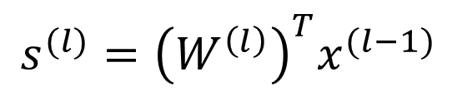

The Linear Signal $s^{(l)}$ into layer $l$
$$s^{(l)}={\left(W^{\left(l\right)}\right)}^{T}x^{(l−1)}$$
at layer $l$
$s^{(l)}$ is a linear combination (using $W^{(l)}$)
of the outputs of the previous layer $x^{(l−1)}$
$\left[\begin{aligned}s_{1}^{(l)} \\ s_{2}^{(l)} \\ ⋮ \\ s_{i}^{(l)} \\ ⋮ \\ s_{d^{(l)}}^{(l)}\end{aligned}\right]=\left[\begin{aligned}{\left(w_{1}^{\left(l\right)}\right)}^{T}− \\ {\left(w_{2}^{\left(l\right)}\right)}^{T}− \\ ⋮ \\ {\left(w_{i}^{\left(l\right)}\right)}^{T}− \\ ⋮ \\ {\left(w_{d^{(l)}}^{\left(l\right)}\right)}^{T}−\end{aligned}\right]x^{(l−1)}$
from
$$s_{i}^{(l)}={\left(w_{i}^{\left(l\right)}\right)}^{T}x^{(l−1)}$$
at each node $i$ in layer $l$

Slide 25

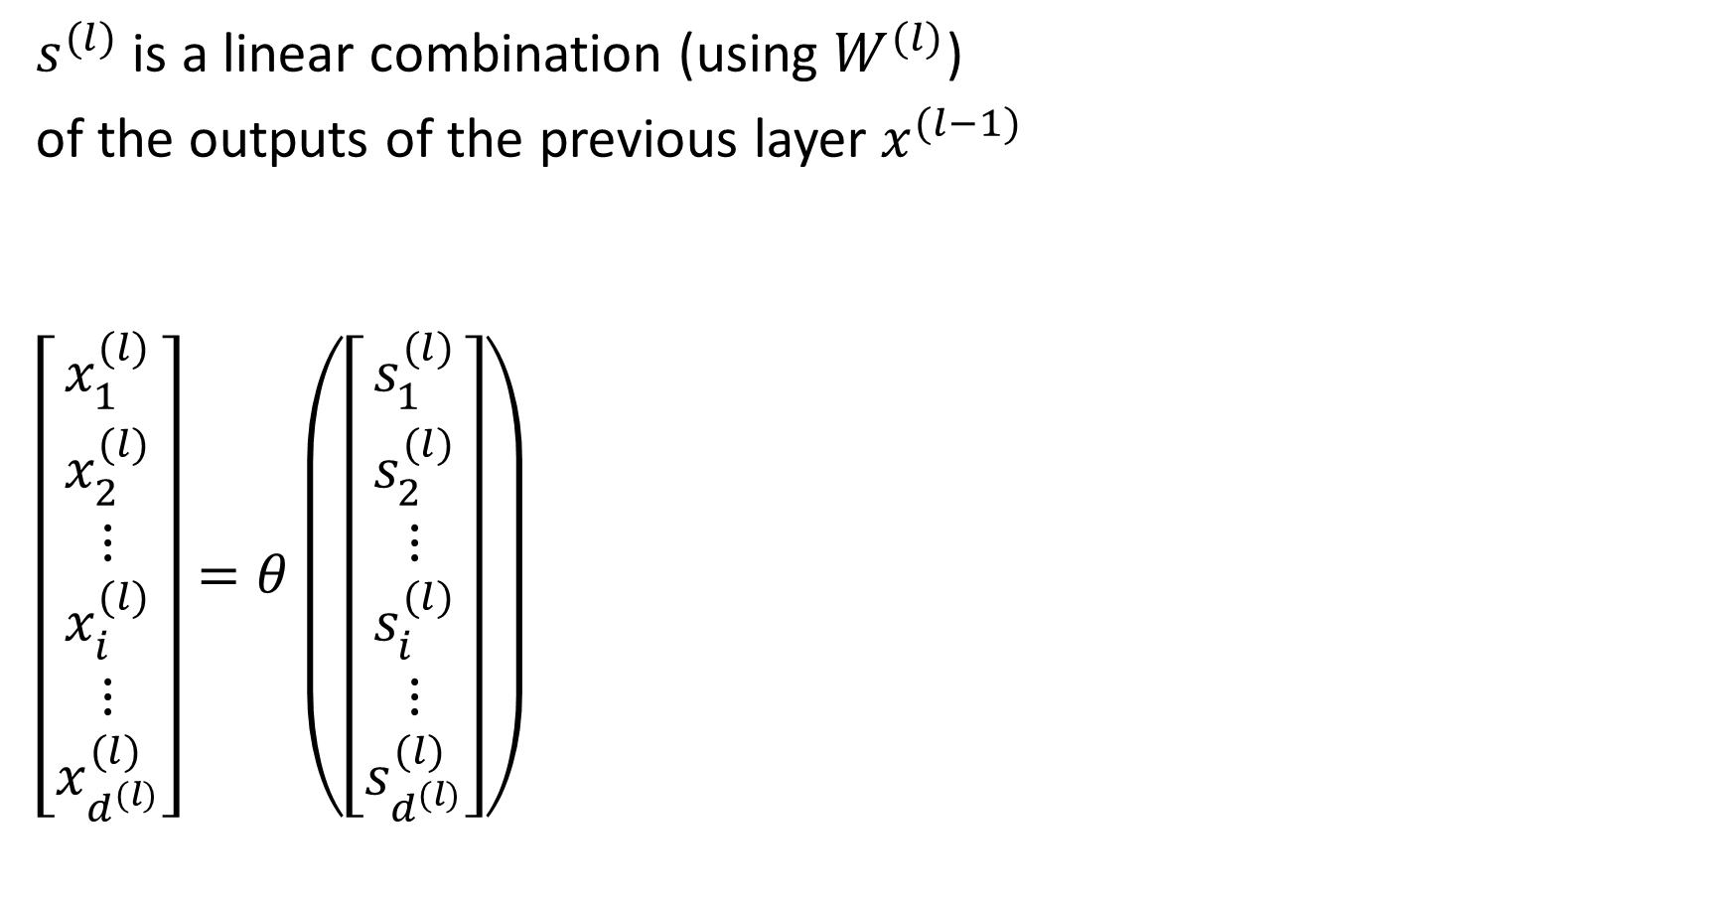
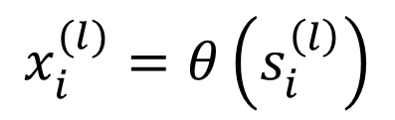

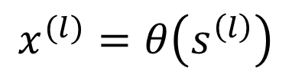

The Output $x^{(l)}$ out of layer $l$
$$x^{(l)}=θ\left(s^{\left(l\right)}\right)$$
at layer $l$
$s^{(l)}$ is a linear combination (using $W^{(l)}$)
of the outputs of the previous layer $x^{(l−1)}$
$\left[\begin{aligned}x_{1}^{(l)} \\ x_{2}^{(l)} \\ ⋮ \\ x_{i}^{(l)} \\ ⋮ \\ x_{d^{(l)}}^{(l)}\end{aligned}\right]=θ\left(\left[\begin{aligned}s_{1}^{(l)} \\ s_{2}^{(l)} \\ ⋮ \\ s_{i}^{(l)} \\ ⋮ \\ s_{d^{(l)}}^{(l)}\end{aligned}\right]\right)$
from
$$x_{i}^{(l)}=θ\left(s_{i}^{\left(l\right)}\right)$$
at each node $i$ in layer $l$

Slide 26
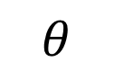
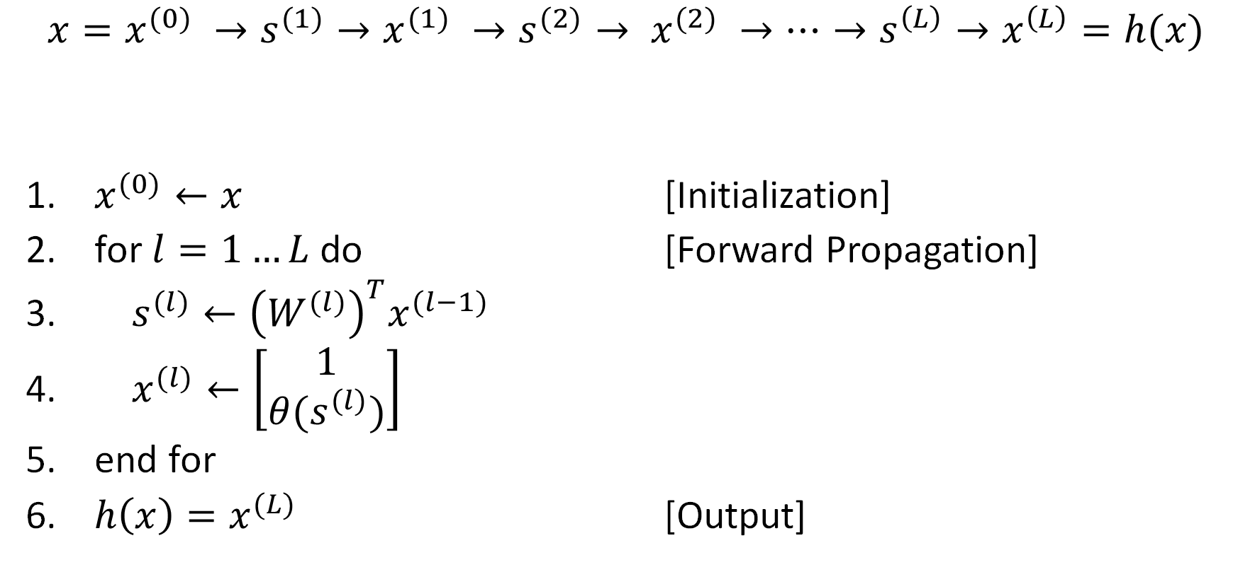
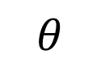

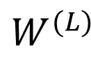
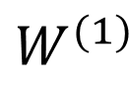
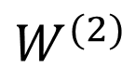
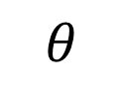
Forward Propagation: Computing $h(x)$
$$W^{(1)}$$
$$θ$$
$$W^{(2)}$$
$$θ$$
$$W^{(L)}$$
$$θ$$
$$x=x^{(0)} →s^{(1)}→x^{(1)} →s^{(2)}→ x^{(2)} →…→s^{\left(L\right)}→x^{\left(L\right)}=h(x)$$
$x^{(0)}←x$ [Initialization]
for $l=1…L$ do [Forward Propagation]
$s^{(l)}←{\left(W^{(l)}\right)}^{T}x^{(l−1)}$
$x^{(l)}←\left[\begin{aligned}1 \\ θ(s^{(l)})\end{aligned}\right]$
end for
$h\left(x\right)=x^{(L)}$ [Output]

Slide 27
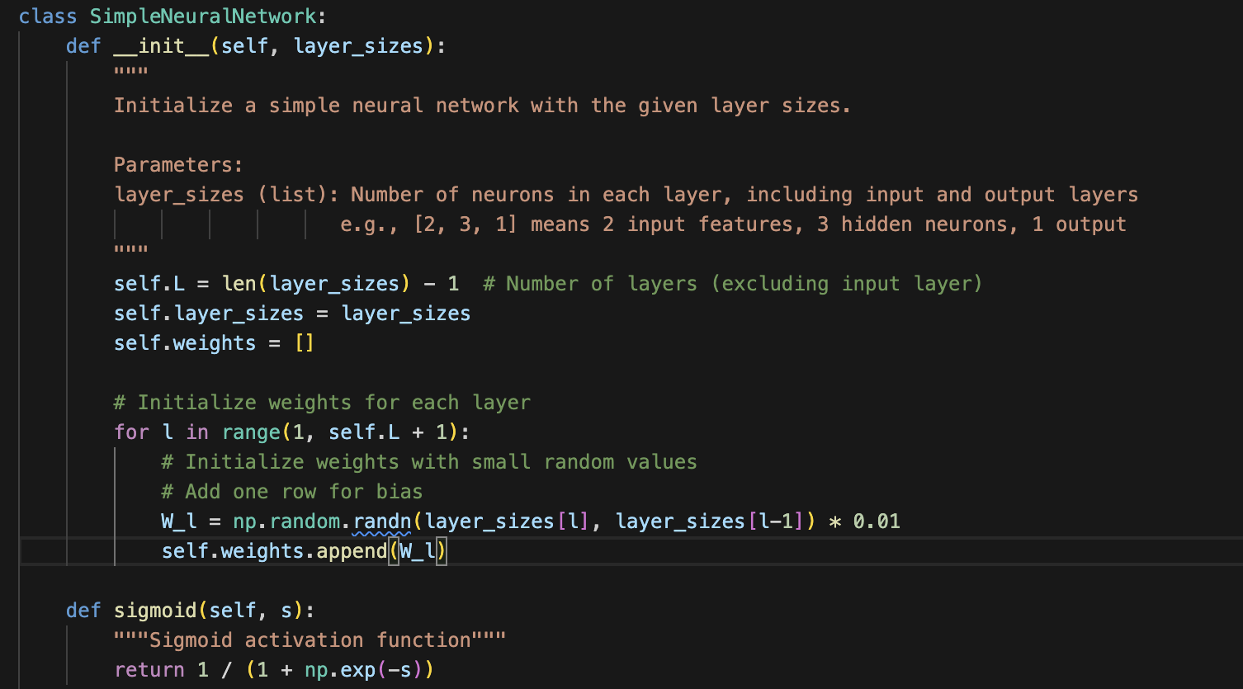

Slide 28
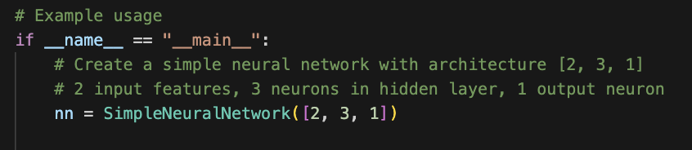
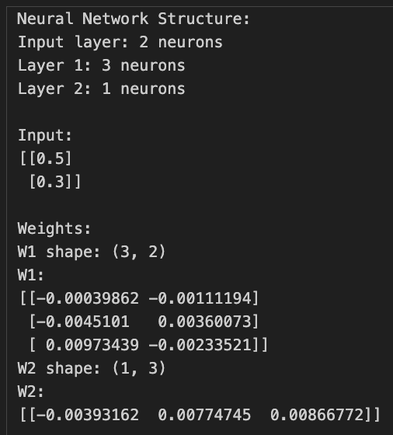

Slide 29
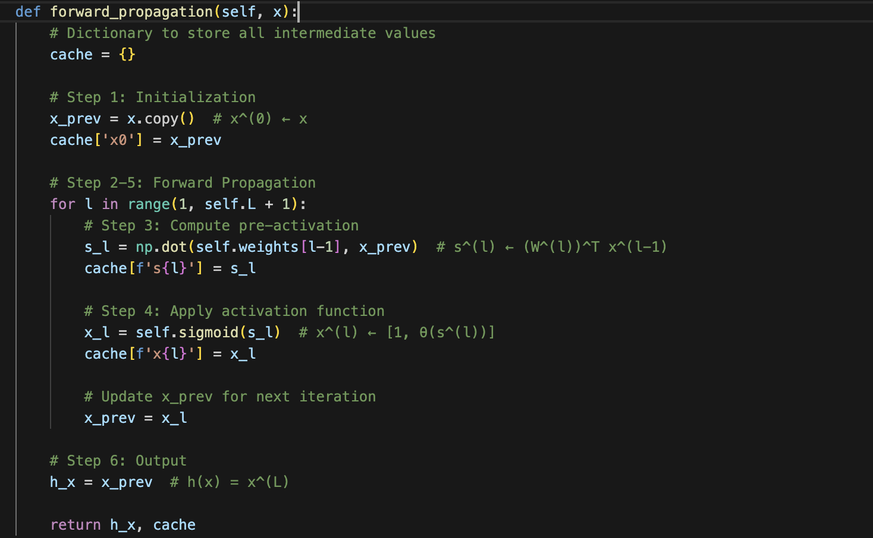

Slide 30
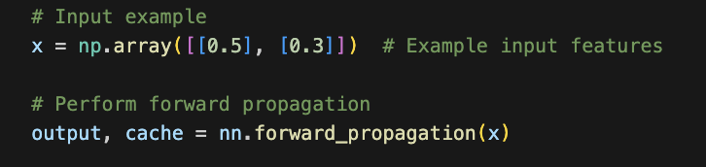
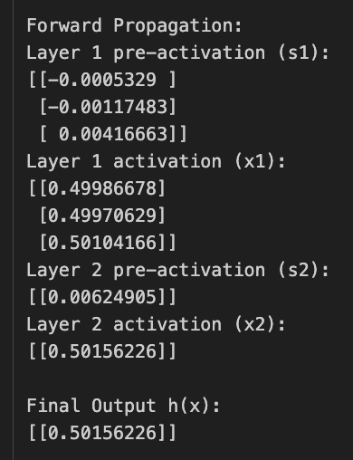

Slide 31
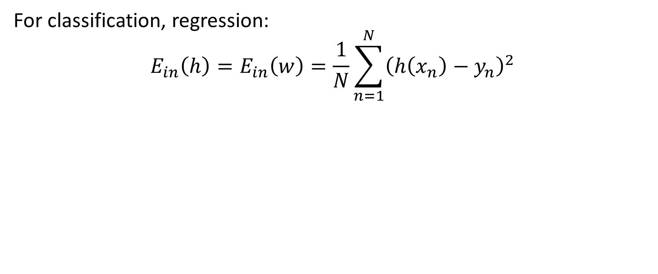

What is $E_{in}(h)$?
For classification, regression:
$$E_{in}\left(h\right)=E_{in}\left(w\right)=\frac{1}{N}\sum_{n=1}^{N}{{\left(h\left(x_{n}\right)−y_{n}\right)}^{2}}$$

Slide 32



Fitting the Data: Minimizing $E_{in}$
$$E_{in}\left(h\right)=E_{in}\left(W\right)=\frac{1}{N}\sum_{n=1}^{N}{{\left(h\left(x_{n}\right)−y_{n}\right)}^{2}}$$
where $W=\left\{W^{\left(1\right)},W^{\left(2\right)},…,W^{\left(L\right)}\right\}$
Using $θ=tanh{(⋅)}$
instead of $sign(⋅)$
makes $E_{in}\left(W\right)$
differentiable
Allows using
gradient descent

Slide 33

Gradient Descent
$$W\left(t+1\right)=W\left(t\right)−η∇E_{in}\left(W\left(t\right)\right)$$
$$W^{(l)}←W^{(l)}−η\frac{∂E_{in}}{∂W^{(l)}}$$
Need to compute the gradient of $E_{in}$ at $W^{(t)}$

Slide 34


Gradient of $E_{in}$
Given weights $W$,
$$E_{in}\left(W\right)=\frac{1}{N}\sum_{n=1}^{N}{e_{n}}=\frac{1}{N}\sum_{n=1}^{N}{e(h\left(x_{n};W\right),y_{n})}$$
the gradient of $E_{in}(W)$ is:
$$\frac{∂E_{in}(W)}{∂W^{\left(l\right)}}=\frac{1}{N}\sum_{n=1}^{N}{\frac{∂e\left(h\left(x_{n}\right),y_{n}\right)}{∂W^{(l)}}}$$
Need $\frac{∂e\left(x\right)}{∂W^{(l)}}$

Slide 35





















The Neural Network
Defined by:
$$W=\{W^{\left(1\right)},W^{\left(2\right)},…,W^{\left(L\right)}\}$$
$$W^{(l)}$$
$$W^{(l+1)}$$
$$W^{(L)}$$
$$1$$
$$1$$
$$1$$
$$x_{1}$$
$$θ$$
$$θ$$
$$θ$$
$$h(x)$$
$$x_{2}$$
$$θ$$
$$θ$$
$$d^{(l+1)}$$
$$⋮$$
$$θ$$
$$d^{(l)}$$
How many nodes in the neural network?
How many weights do we have to learn?
How many computations of $θ$?
How many multiplications to compute $E_{in}\left(W\right)$
$$x_{d}$$

Slide 36



Computing the Gradient: Numerical, Finite Difference Approach
$$\frac{∂e\left(x\right)}{∂W_{ij}^{\left(l\right)}}≈\frac{e\left(x | W_{ij}^{\left(l\right)}+Δ\right)−e\left(x | W_{ij}^{\left(l\right)}−Δ\right)}{2Δ}$$
for some finite “tolerance” $Δ$
Approximate and inefficient ☹
$$O\left(\left(N\left|W\right|+N\left|V\right|\right)\left|W\right|\right)$$
# multiplications to compute error
after perturbations
for each $W_{ij}^{\left(l\right)}$
# $θ\left(⋅\right)$ computations

Slide 37

Backpropagation
$$O\left(\left(N\left|W\right|+N\left|V\right|\right)\left|W\right|\right)$$
A Dynamic Programming Algorithm

Slide 38

Gradient Descent Algorithm: Computing $E_{in}(w)$ and gradient $g=∇E_{in}(w)$
Input: weights $w=\left(W^{\left(1\right)},…,W^{\left(L\right)}\right)$
Output: error $E_{in}(w)$ and gradient $g=∇E_{in}(w)$
1. Initialize $E_{in}=0$, for $l=1,…,L, G^{\left(l\right)}=0 ⋅W^{(l)}$
2. For each data point $x_{n}, n=1,…, N$ do
3. Compute outputs $x^{(l)}$ for $l=1,…,L$ using forward propagation
4. Compute sensitivities $δ^{(l)}$ for $l=1,…,L$ using back propagation
5. $E_{in}←E_{in}+\frac{1}{N}{\left(x_{1}^{\left(L\right)}−y_{n}\right)}^{2}$
6. For $l=1,…,L$ do
7. $G^{\left(l\right)}\left(x_{n}\right)=\left[x^{\left(l\right)}{\left(δ^{(l)}\right)}^{T}\right]$ // the gradient of $E_{in}(w)$ at $x_{n}$
8. $G^{(l)}←G^{(l)}+\frac{1}{N}G^{\left(l\right)}(x_{n})$ // the gradient of $E_{in}(w)$
9. End For
10. End For
While stopping condition not met, do:
Update weights $W^{(l)}←W^{(l)}−ηG^{(l)}$ for all $l∈\{1,…, L\}$

Slide 39


Backpropagation To Compute Sensitivities $$δ^{(1)}←…←δ^{(L−2)}←δ^{(L−1)}←δ^{(L)}$$
1. Forward Propagation to compute $x^{(l)}$, $s^{(l)}$ for $l=1,…,L$
2. Set $δ^{(L)}←2(x^{\left(L\right)}−y)θ′(s^{(L)})$
$θ^{′}\left(s^{\left(L\right)}\right)=1−{\left(x^{(L)}\right)}^{2}$
3. For $l=L−1, …, 1$ do
4. Compute for each $\tanh{(⋅)}$ hidden node:
$$θ^{′}\left(s^{\left(l\right)}\right)={\left[1−x^{\left(l\right)}⊙x^{\left(l\right)}\right]}_{1}^{d^{(l)}}$$
5. Compute sensitivity $δ^{(l)}$ from $δ^{(l+1)}$
$δ^{(l)}←θ^{′}\left(s^{\left(l\right)}\right)⊙{\left[W^{\left(l+1\right)}δ^{(l+1)}\right]}_{1}^{d^{(l)}}$
6. End For

Slide 40










Recap of Forward Propagation
Node $i$ only affects the output $h(x)$
through its input $s_{i}^{\left(l\right)}$
Input
Signal
+
node $i$
$$x^{(l−1)}$$
$$W^{(l)}$$
$$s^{(l)}$$
$$θ$$
$$x^{(l)}$$
$$⋯$$
$$h(x)$$
layer $l$

Slide 41





Computing the Gradient: Using the Chain Rule
Node $i$ only affects the output $h(x)$
through its input $s_{i}^{\left(l\right)}$
$$\frac{∂e}{∂W_{i}^{\left(l\right)}}=\frac{∂s_{i}^{\left(l\right)}}{∂W_{i}^{(l)}}⋅\frac{∂e}{∂s_{i}^{(l)}}$$
$s_{i}^{(l)}={\left(W_{i}^{(l)}\right)}^{T}x^{\left(l−1\right)}$ $⇒\frac{∂s_{i}^{\left(l\right)}}{∂W_{i}^{(l)}}=x^{\left(l−1\right)}$
[chain rule]
how error changes w.r.t. $W_{i}^{(l)}$
how error
changes w.r.t. $s_{i}^{(l)}$
how input signal
changes w.r.t. $W_{i}^{(l)}$
$≈$ follows from linearity in the weights

Slide 42



Using the Chain Rule: Node $i$, Layer $l$
Node $i$ only affects the output $h(x)$
through its input $s_{i}^{\left(l\right)}$
$$\frac{∂e}{∂W_{i}^{\left(l\right)}}=\frac{∂s_{i}^{\left(l\right)}}{∂W_{i}^{(l)}}⋅\frac{∂e}{∂s_{i}^{(l)}}$$
$=x_{i}^{(l−1)}⋅\frac{∂e}{∂s_{i}^{(l)}}$
$s_{i}^{(l)}={\left(W_{i}^{(l)}\right)}^{T}x^{\left(l−1\right)}$ $⇒\frac{∂s_{i}^{\left(l\right)}}{∂W_{i}^{(l)}}=x^{\left(l−1\right)}$
[chain rule]
Backpropagation:
Computes this sensistivity
of e to $s_{i}^{(l)}$

Slide 43



Using the Chain Rule: Layer $l$
$e\left(x\right)$ is a function of $s^{(l)}$
and $s^{(l)}={\left(W^{(l)}\right)}^{T}x^{(l−1)}$
$$\frac{∂e}{∂W^{(l)}}=\dot{\frac{∂s^{\left(l\right)}}{∂W^{\left(l\right)}}}{\left(\frac{∂e}{∂s^{\left(l\right)}}\right)}^{T}$$
$=x^{\left(l−1\right)}{\left(δ^{\left(l\right)}\right)}^{T}$
sensitivity $δ^{(l)}=\frac{∂e}{∂s^{(l)}}$ w.r.t. input $s^{(l)}$ to layer $l$
[chain rule]
$\left(d^{\left(l−1\right)}+1\right)×d^{(l)}$
matrix of partial derivatives

Slide 44




Using the Chain Rule: Layer $l$
$$\frac{∂e}{∂W^{(l)}}=\dot{\frac{∂s^{\left(l\right)}}{∂W^{\left(l\right)}}}{\left(\frac{∂e}{∂s^{\left(l\right)}}\right)}^{T}$$
$=x^{\left(l−1\right)}{\left(δ^{\left(l\right)}\right)}^{T}$
sensitivity of $e$ to $s^{(l)}$, the input to layer $l$
output of layer $l−1$
Forward Propagation
?

Slide 45


Recap of Forward Propagation
Input
Signal
+
node $i$
$$x^{(l−1)}$$
$$W^{(l)}$$
$$s^{(l)}$$
$$θ$$
$$x^{(l)}$$
$$⋯$$
$$h(x)$$
layer $l$

Slide 46



Sensitivity: Using the Chain Rule Again @ Node $i$, Layer $l$
$$x_{i}^{(l)}=θ\left(s_{i}^{(l)}\right)$$
$$δ_{i}^{\left(l\right)}=\frac{∂e}{∂s_{i}^{(l)}}=\frac{∂e}{∂x_{i}^{(l)}}\frac{∂x_{i}^{(l)}}{∂s_{i}^{(l)}}$$
$=θ^{′}\left(s_{i}^{\left(l\right)}\right)\frac{∂e}{∂x_{i}^{(l)}}$

Slide 47





Sensitivity: Using the Chain Rule Again @ Layer $l$
$$x^{(l)}=θ\left(s^{(l)}\right)$$
$$δ^{(l)}=\frac{∂e}{∂s^{(l)}}=\frac{∂e}{∂x^{(l)}}\frac{∂x^{(l)}}{∂s^{(l)}}$$
$=θ^{′}\left(s^{\left(l\right)}\right)⊙{\left[\frac{∂e}{∂x^{\left(l\right)}}\right]}_{1}^{d^{\left(l\right)}}$
$d^{(l)}$ components
$$\frac{d\tanh\left(x\right)}{dx}=1−\tanh^{2}{(x)}$$
component-wise
multiplication

Slide 48






Recap of Forward Propagation
Input
Signal
+
node $k$
$$x^{(l)}$$
$$W^{(l+1)}$$
$$s^{(l+1)}$$
$$θ$$
$$x^{(l+1)}$$
$$⋯$$
$$h(x)$$
layer $l+1$

Slide 49


Sensitivity
$$δ^{(l)}=\frac{∂e}{∂s^{(l)}}=θ^{′}\left(s^{\left(l\right)}\right)⊙{\left[\frac{∂e}{∂x^{\left(l\right)}}\right]}_{1}^{d^{\left(l\right)}}$$
$$\frac{∂e}{∂x^{(l)}}=\sum_{k=1}^{d^{(l+1)}}{\frac{∂e}{∂s_{k}^{\left(l+1\right)}}⋅\frac{∂s_{k}^{(l+1)}}{∂x^{(l)}}}$$
where $s_{k}^{(l+1)}={\left(W_{k}^{\left(l+1\right)}\right)}^{T}x^{(l)}={\left(x^{(l)}\right)}^{T}W_{k}^{\left(l+1\right)}$
$$⇒\frac{∂s_{k}^{(l+1)}}{∂x^{(l)}}=W_{k}^{(l+1)}$$
$d^{(l)}$ components

Slide 50



Sensitivity
$$δ^{(l)}=\frac{∂e}{∂s^{(l)}}=θ^{′}\left(s^{\left(l\right)}\right)⊙{\left[\frac{∂e}{∂x^{\left(l\right)}}\right]}_{1}^{d^{\left(l\right)}}$$
$$\frac{∂e}{∂x^{(l)}}=\sum_{k=1}^{d^{(l+1)}}{\frac{∂e}{∂s_{k}^{\left(l+1\right)}}⋅\frac{∂s_{k}^{(l+1)}}{∂x^{(l)}}}$$
$d^{(l)}$ components
$$δ^{(l+1)}$$
$$W_{k}^{(l+1)}$$

Slide 51

Sensitivity
$$δ^{(l)}=\frac{∂e}{∂s^{(l)}}=θ^{′}\left(s^{\left(l\right)}\right)⊙{\left[\frac{∂e}{∂x^{\left(l\right)}}\right]}_{1}^{d^{\left(l\right)}}$$
$$\frac{∂e}{∂x^{\left(l\right)}}=\sum_{k=1}^{d^{(l+1)}}{W_{k}^{(l+1)}}\frac{∂e}{∂s_{k}^{\left(l+1\right)}}$$
$$=W^{(l+1)}\frac{∂e}{∂s^{\left(l+1\right)}}=W^{(l+1)}δ^{(l+1)}$$
$d^{(l)}$ components
$d^{(l)}$ components

Slide 52

Sensitivity
$$δ^{(l)}=\frac{∂e}{∂s^{(l)}}=θ^{′}\left(s^{\left(l\right)}\right)⊙{\left[W^{(l+1)}δ^{(l+1)}\right]}_{1}^{d^{\left(l\right)}}$$
Yay!
We can now compute,
$$\frac{∂e}{∂W^{(l)}}=x^{\left(l−1\right)}{\left(δ^{\left(l\right)}\right)}^{T}$$
How to compute $δ^{\left(l\right)}$? $δ^{(l)}←…←δ^{(L−2)}←δ^{(L−1)}←δ^{(L)}$
If we can just compute $δ^{(L)}$

Slide 53



Computing $δ^{(L)}$
$$δ^{(L)}=\frac{∂e}{∂s^{(L)}}$$
$=\frac{∂{\left(x^{\left(L\right)}−y\right)}^{2}}{∂s^{(L)}}$
$=2\left(x^{\left(L\right)}−y\right)\frac{∂x^{\left(L\right)}}{∂s^{(L)}}$
$=2\left(x^{\left(L\right)}−y\right)θ^{′}\left(s^{\left(L\right)}\right)$
$=\left(x^{\left(L\right)}−y\right)\left(1−\tanh^{2}\left(s^{\left(L\right)}\right)\right)$
$=\left(x^{\left(L\right)}−y\right)\left(1−{\left(x^{\left(L\right)}\right)}^{2} \right)$
$$\frac{d\tanh{(x)}}{dx}=1−\tanh^{2}\left(x\right)$$

Slide 54

Components of the Backpropagation Algorithm
$$\frac{∂e}{∂W^{(l)}}=x^{\left(l−1\right)}{\left(δ^{\left(l\right)}\right)}^{T}$$
where
$$δ^{(l)}=θ^{′}\left(s^{\left(l\right)}\right)⊙{\left[W^{(l+1)}δ^{(l+1)}\right]}_{1}^{d^{\left(l\right)}}$$

Slide 55

Backpropagation To Compute Sensitivities $$δ^{(1)}←…←δ^{(L−2)}←δ^{(L−1)}←δ^{(L)}$$
1. Forward Propagation to compute $x^{(l)}$, $s^{(l)}$ for $l=1,…,L$
2. Set $δ^{(L)}←2(x^{\left(L\right)}−y)θ′(s^{(L)})$
$θ^{′}\left(s^{\left(L\right)}\right)=1−{\left(x^{(L)}\right)}^{2}$
3. For $l=L−1, …, 1$ do
4. Compute for each $\tanh{(⋅)}$ hidden node:
$$θ^{′}\left(s^{\left(l\right)}\right)={\left[1−x^{\left(l\right)}⊙x^{\left(l\right)}\right]}_{1}^{d^{(l)}}$$
5. Compute sensitivity $δ^{(l)}$ from $δ^{(l+1)}$
$δ^{(l)}←θ^{′}\left(s^{\left(l\right)}\right)⊙{\left[W^{\left(l+1\right)}δ^{(l+1)}\right]}_{1}^{d^{(l)}}$
6. End For

Slide 56



Computing the Gradient: Computing $E_{in}\left(W\right)$ and gradient $g=∇E_{in}\left(W\right)$
Input: weights $W=\{W^{\left(1\right)},…,W^{(L)}\}$
Output: error $E_{in}\left(W\right)$ and gradient $g=∇E_{in}\left(W\right)$
1. Initialize $E_{in}=0$, for $l=1,…,L, G^{\left(l\right)}=0 ⋅W^{(l)}$
2. For each data point $x_{n}, n=1,…, N$ do
3. Compute $x^{(l)}$ for $l=1,…,L$ using forward propagation
4. Compute $δ^{(l)}$ for $l=1,…,L$ using back propagation
5. $E_{in}←E_{in}+\frac{1}{N}{\left(x_{1}^{\left(L\right)}−y_{n}\right)}^{2}$
6. For $l=1,…,L$ do
7. $G^{\left(l\right)}\left(x_{n}\right)=\left[x^{\left(l−1\right)}{\left(δ^{(l)}\right)}^{T}\right]$
8. $G^{(l)}←G^{(l)}+\frac{1}{N}G^{\left(l\right)}(x_{n})$
9. End For
10. End For
to update weights $W^{(l)}←W^{(l)}−ηG^{(l)}$

Slide 57

Gradient Descent Algorithm: Computing $E_{in}(w)$ and gradient $g=∇E_{in}(w)$
Input: weights $w=\left(W^{\left(1\right)},…,W^{\left(L\right)}\right)$
Output: error $E_{in}(w)$ and gradient $g=∇E_{in}(w)$
1. Initialize $E_{in}=0$, for $l=1,…,L, G^{\left(l\right)}=0 ⋅W^{(l)}$
2. For each data point $x_{n}, n=1,…, N$ do
3. Compute outputs $x^{(l)}$ for $l=1,…,L$ using forward propagation
4. Compute sensitivities $δ^{(l)}$ for $l=1,…,L$ using back propagation
5. $E_{in}←E_{in}+\frac{1}{N}{\left(x_{1}^{\left(L\right)}−y_{n}\right)}^{2}$
6. For $l=1,…,L$ do
7. $G^{\left(l\right)}\left(x_{n}\right)=\left[x^{\left(l\right)}{\left(δ^{(l)}\right)}^{T}\right]$ // the gradient of $E_{in}(w)$ at $x_{n}$
8. $G^{(l)}←G^{(l)}+\frac{1}{N}G^{\left(l\right)}(x_{n})$ // the gradient of $E_{in}(w)$
9. End For
10. End For
While stopping condition not met, do:
Update weights $W^{(l)}←W^{(l)}−ηG^{(l)}$ for all $l∈\{1,…, L\}$

Slide 58
Neural Networks Overfit

Slide 59


Neural Networks have a Tunable Transform
Neural Network
$$h\left(x\right)=θ\left(w_{0}+\sum_{j=1}^{m}{w_{j}θ\left(v_{j}^{T}x\right)}\right)$$
Nonlinear Transform
$$h\left(x\right)=θ\left(w_{0}+\sum_{j=1}^{m}{w_{j}Φ_{j}(x)}\right)$$
Fit ‘features’ (transforms)
to the data,
supervised
$$\tilde{d}=m$$

Slide 60


Generalization
MLP ($sign(⋅)$ activation function):
$$d_{VC}=O(md\log{md})$$
where
$d$ is # ‘features’
$m$ is # hidden units
Neural Network ($\tanh{(⋅)}$ activation function):
$d_{VC}=O\left(md\left(m+d\right)\right)$ for 2 layer NN
$d_{VC}=∞$ for sigmoid activation functions in general
Recall: $E_{out}≤E_{in}+O\left(\sqrt{\frac{d_{VC}}{N}\log{N}}\right)$

Slide 61

Generalization
$$E_{out}≤E_{in}+O\left(\sqrt{\frac{d_{VC}}{N}\log{N}}\right)$$
$E_{in}=O\left(\frac{1}{m}\right)$ for regression
$E_{in}=O\left(\frac{1}{\sqrt{m}}\right)$ for classification
Suppose $m=\sqrt{N}$ (in general have $m$ grow sublinearly with $N$)
$E_{in}\sim \frac{1}{N^{\frac{1}{4}}}$, $O\left(\sqrt{\frac{d_{VC}}{N}\log{N}}\right)\sim \frac{1}{N^{\frac{1}{4}}}$
As $N→∞$, $E_{out}→E_{in}$ and $E_{in}→E_{out}^{∗}$, i.e. $E_{out}→E_{out}^{∗}$

Slide 62


Approximation Capability of Neural Networks
$$E_{in}\left(h\right)≤\frac{{\left(2RC_{f}\right)}^{2}}{m}=O\left(\frac{1}{m}\right)$$
where $m$ is the number of hidden units
assuming the target function has complexity at most $C_{f}$
and $R=\max_{n}\left\|x_{n}\right\|$ is the ‘radius’ of the data
(for 1 hidden layer)
sufficiently large $m$
$$⇒E_{in}→0$$

Slide 63
Neural Networks Overfit

Slide 64
Regularization

Slide 65

Regularization – Weight Decay
$$E_{aug}\left(w\right)=E_{in}\left(w\right)+\frac{λ}{N}{\sum_{l,i,j}{\left(w_{ij}^{\left(l\right)}\right)}}^{2}$$
$$\frac{∂E_{aug}(w)}{∂W^{(l)}}=\frac{∂E_{in}(w)}{∂W^{(l)}}+\frac{2λ}{N}W^{(l)}$$

Slide 66

Early Stopping
Use a validation step to decide when to stop
When reducing $E_{in}$ does not reduce $E_{val}$

Slide 67









When to Stop?
$$w\left(1\right)$$
$$w\left(0\right)$$
$$w\left(1\right)$$
$$w\left(0\right)$$
$$w\left(2\right)$$
$$w\left(1\right)$$
$$w\left(3\right)$$
$$w\left(0\right)$$
$$w\left(2\right)$$

Slide 68

Variable Learning Rate
Set $α>1$, $β<1$,
Compute gradient $g\left(t\right)$ at weights $w\left(t\right)$
If $E_{in}\left(w\left(t\right)−ηg(t)\right)<E_{in}(w(t))$ do
accept: $w\left(t+1\right)=w\left(t\right)−ηg(t)$
$η=αη$, increase the learning rate
Else:
reject: $w\left(t+1\right)=w\left(t\right)$
$η=βη$, decrease learning rate

Slide 69

Steepest Descent
initialize $t←0$ and weights $w(0)$
while stopping criterion not met do
Let $g\left(t\right)=∇E_{in}\left(w\left(t\right)\right)$ and set $v\left(t\right)←−g(t)$
Let $η^{∗}=\arg{\min_{eta}{E_{in}\left(w\left(t\right)+ηv\left(t\right)\right)}}$
$w\left(t+1\right)=w\left(t\right)+η^{∗}v(t)$
Iterate to next step $t←t+1$
end while

Slide 70
Comparison of Optimization Heuristics

Slide 71
Forward Propagation: Computing $h(x)$
$$W^{(1)}$$
$$θ$$
$$W^{(2)}$$
$$θ$$
$$W^{(L)}$$
$$θ$$
$$x=x^{(0)} →s^{(1)}→x^{(1)} →s^{(2)}→ x^{(2)} →…→s^{\left(L\right)}→x^{\left(L\right)}=h(x)$$
$x^{(0)}←x$ [Initialization]
for $l=1…L$ do [Forward Propagation]
$s^{(l)}←{\left(W^{(l)}\right)}^{T}x^{(l−1)}$
$x^{(l)}←\left[\begin{aligned}1 \\ θ(s^{(l)})\end{aligned}\right]$
end for
$h\left(x\right)=x^{(L)}$ [Output]

Slide 72
Backpropagation To Compute Sensitivities $$δ^{(1)}←…←δ^{(L−2)}←δ^{(L−1)}←δ^{(L)}$$
1. Forward Propagation to compute $x^{(l)}$, $s^{(l)}$ for $l=1,…,L$
2. Set $δ^{(L)}←2(x^{\left(L\right)}−y)θ′(s^{(L)})$
$θ^{′}\left(s^{\left(L\right)}\right)=1−{\left(x^{(L)}\right)}^{2}$
3. For $l=L−1, …, 1$ do
4. Compute for each $\tanh{(⋅)}$ hidden node:
$$θ^{′}\left(s^{\left(l\right)}\right)={\left[1−x^{\left(l\right)}⊙x^{\left(l\right)}\right]}_{1}^{d^{(l)}}$$
5. Compute sensitivity $δ^{(l)}$ from $δ^{(l+1)}$
$δ^{(l)}←θ^{′}\left(s^{\left(l\right)}\right)⊙{\left[W^{\left(l+1\right)}δ^{(l+1)}\right]}_{1}^{d^{(l)}}$
6. End For

Slide 73

A Problem: The Vanishing Gradient
$δ^{(l)}←θ^{′}\left(s^{\left(l\right)}\right)⊙{\left[W^{\left(l+1\right)}δ^{(l+1)}\right]}_{1}^{d^{(l)}}$
$δ^{(l)}←θ^{′}\left(s^{\left(l\right)}\right)⊙{\left[W^{\left(l+1\right)}\left[θ^{′}\left(s^{\left(l+1\right)}\right)⊙{\left[W^{\left(l+2\right)}δ^{\left(l+2\right)}\right]}_{1}^{d^{\left(l+1\right)}}\right]\right]}_{1}^{d^{(l)}}$
$δ^{(l)}←θ^{′}\left(s^{\left(l\right)}\right)⊙{\left[W^{\left(l+1\right)}\left[θ^{′}\left(s^{\left(l+1\right)}\right)⊙{\left[W^{\left(l+2\right)}[θ^{′}\left(s^{\left(l+2\right)}\right)⊙{\left[W^{\left(l+3\right)}δ^{(l+3)}\right]}_{1}^{d^{(l+2)}}]\right]}_{1}^{d^{\left(l+1\right)}}\right]\right]}_{1}^{d^{(l)}}$
$$\left|θ^{′}\left(s^{\left(l\right)}\right)\right|<1$$
As $L$ increases, product $→0$

Slide 74


A Solution: The ReLU
Rectified Linear Unit (ReLU)
$relu\left(s\right)=\max\left\{0,s\right\}$
derivative:
$\frac{d}{ds}relu\left(s\right)=\left\{\begin{aligned}1,if s≥0 \\ 0, otherwise\end{aligned} \right.$
Also promote sparsity (few nonzero weights)
Parameterized ReLU (PReLU)
$prelu\left(x\right)=\left\{\begin{aligned}s,if s≥0 \\ as, if s<0\end{aligned}\right.$, where $a$ is a learnable parameter

Slide 75
A Similar Problem: Exploding Gradient
Multiplying many large values for the partial derivatives
Causes large gradients
Causes numerical instability
Some solutions:
Redesign the neural network
Reinitialize the weights
Gradient clipping $\left\|G\right\|≤c$ (scale down the gradients so norm is under budget)
Use weight decay regularization

Slide 76
Breaking the symmetry during initialization
Symmetry (e.g. by setting the same weight for all edges) can cause:
Backpropagation only scales all weights equally
Cannot train the neural network
Random initialization (Uniform distribution)
Xavier initialization (Uniform distribution from network statistics)
Never set to constant across each layer
Never set to extreme large values
Another solution: Dropout (covered later)

Slide 77
Dropout Regularization
During Training only
Randomly set the output of a few nodes to 0
Artificially pretends as if there are fewer nodes
Make noisier predictions
Can specify dropout rate
at each layer
$$W^{(l)}$$
$$W^{(l+1)}$$
$$θ$$
$$s_{i}^{(l)}$$
$$x_{i}^{(l)}$$
+
$$θ$$
$$W_{ji}^{\left(l\right)}$$
Example implementation:
$$x_{i}^{(l)}=θ\left(ρ_{i}^{\left(l\right)}s_{i}^{(l)}\right)$$
where $ρ_{i}^{(l)}$ is a Bernoulli random variable
$i$-th node
layer
$$l−1$$
layer
$$l$$
layer
$$l+1$$

Slide 78
Take-Away Quiz (Quiz 4)
Implement ANY 2 solutions to counteract overfitting
Query GPT or Claude to generate codes
Submit ipynb or py files
In your codes, highlight which parts are your counteracting mechanism

